Slide 1

Building Multi Agent RL Baselines in Unity
Shahar Gottlieb
Rotem Levinson
Supervisor: Orr Krupnik

Slide 2
RL intro
Machine learning
Reinforcement learning
DDPG
Multi agent
MADDPG
Notes:
- הפלאפונים סובבים אותנו. לכל אחד יש ולמה לא לנצל את זה לטובת איסוף מידע?
Personal cellphones have become an integral part of our lives
Many Applications, such as “waze”, are using that to create a large and effective database
Our concept is based on this principle while using many inner sensors onboard our cellphones, at any given time (such as temperature, gyro, magnetic field etc.)
the goal is to make an interactive map which shows processed sensors information acquired from cellphones that use the application

Slide 3
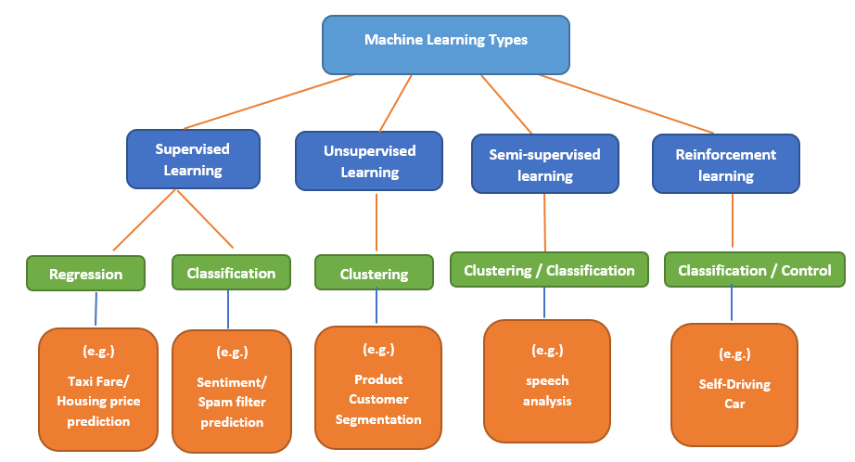
Machine learning
Learn and improve from experience without being explicitly programmed.

Slide 4
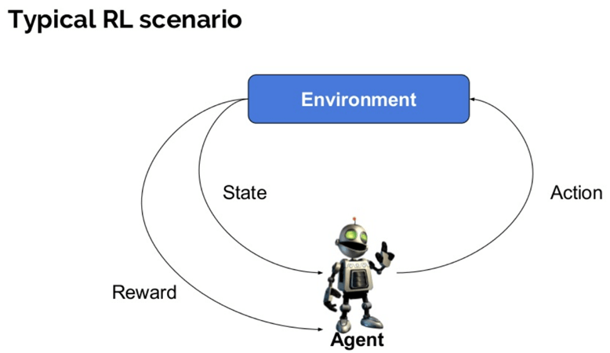
Reinforcement Learning
RL Agent performs in an environment, collects observations, gets rewarded, and learns how to act.

Slide 5

Deep Deterministic Policy Gradient (DDPG)
Some Notations:
State: $s_{t}$
Action: $a_{t}$
Reward: $r_{t}$
Discount: $γ$
Trajectory: $τ=(a_{0}, s_{0}, a_{1}, s_{1},…)$
Policy: $π$
Cumulative Reward: $R(τ)=\sum_{t=0}^{∞}{γ^{t}⋅r(}s_{t}, a_{t},s_{t+1})$
Optimal Policy: $π^{∗}=argmax_{π}(E_{τ\left(π\right)}\left[R\left(τ\right)\right])$
Q function (with bellman equation):
$Q^{∗}\left(s,a\right)=E_{τ\left(π^{∗}\right)}\left[R\left(τ\right)\right|s_{0}=s, a_{0}=a]$ = $E_{s^{′}∼P}\left[r\left(s,a\right)+γQ^{∗}\left(s^{′},{a^{′}=π}^{∗}(s^{′})\right)\right]$

Slide 6
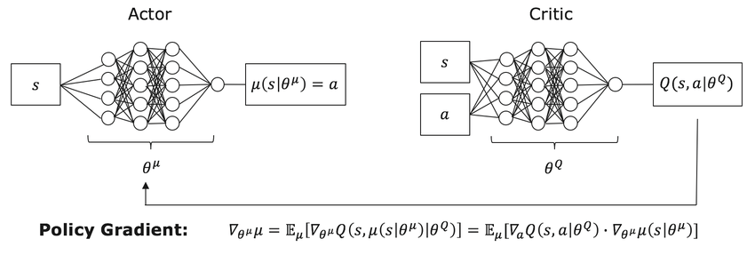

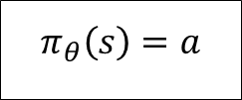
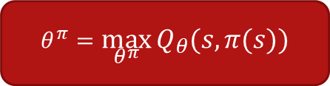
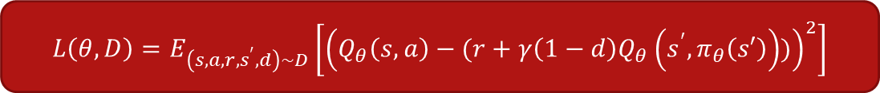
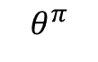
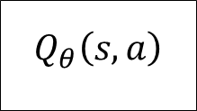
Deep Deterministic Policy Gradient (DDPG)
$$π_{θ}\left(s\right)=a$$
$$Q_{θ}\left(s,a\right)$$
$$θ^{π}$$
$$L\left(θ, D\right)=E_{\left(s,a,r,s^{′},d\right)∼D}\left[{\left(Q_{θ}\left(s,a\right)−(r+γ\left(1−d\right)Q_{θ}\left(s^{′},π_{θ}\left(s′\right)\right))\right)}^{2}\right]$$
$$θ^{π}=\max_{θ^{π}}{Q_{θ}(s, π(s))}$$
$$θ^{Q}=\min_{θ^{Q}}{L(θ, D)}$$

Slide 7
The Multi Agent Problem
How can an agent learn when other agents are around?
Not stationary any more
High compute
Why do we need this?
Real life problems – not alone in the world
The future of AI
Development environments
Not possible to train in real environment (driving cars)
Needed to save time (fast forward the training)
Hard to simulate real life environment

Slide 8
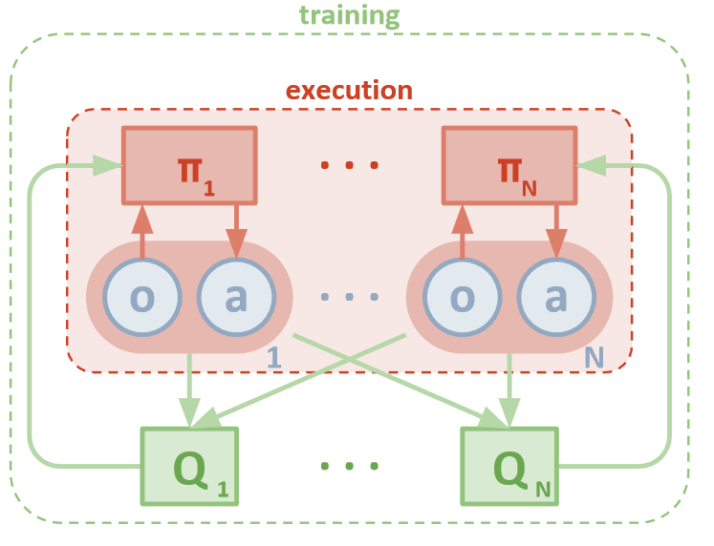
Multi-Agent DDPG (MADDPG) Lowe et al., 2017
Multiple agents
Multiple critics
Partial observations for actors
Full observations for critics

Slide 9
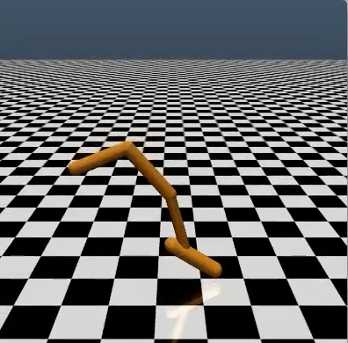
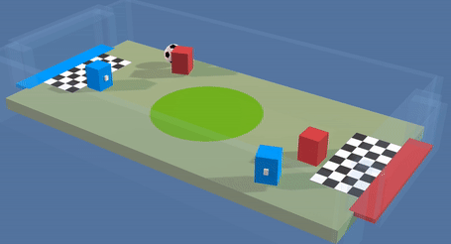

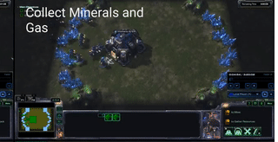
Existing Environments
?
Notes:
- הפלאפונים סובבים אותנו. לכל אחד יש ולמה לא לנצל את זה לטובת איסוף מידע?
Personal cellphones have become an integral part of our lives
Many Applications, such as “waze”, are using that to create a large and effective database
Our concept is based on this principle while using many inner sensors onboard our cellphones, at any given time (such as temperature, gyro, magnetic field etc.)
the goal is to make an interactive map which shows processed sensors information acquired from cellphones that use the application

Slide 10
Motivation
Reinforcement Learning is a Hot Topic
Variety of environments needed for effective research.
The current existing solutions are insufficient.
Limited number of agents
Easy environments
Not realistic enough
Not scalable
Notes:
- הפלאפונים סובבים אותנו. לכל אחד יש ולמה לא לנצל את זה לטובת איסוף מידע?
Personal cellphones have become an integral part of our lives
Many Applications, such as “waze”, are using that to create a large and effective database
Our concept is based on this principle while using many inner sensors onboard our cellphones, at any given time (such as temperature, gyro, magnetic field etc.)
the goal is to make an interactive map which shows processed sensors information acquired from cellphones that use the application

Slide 11
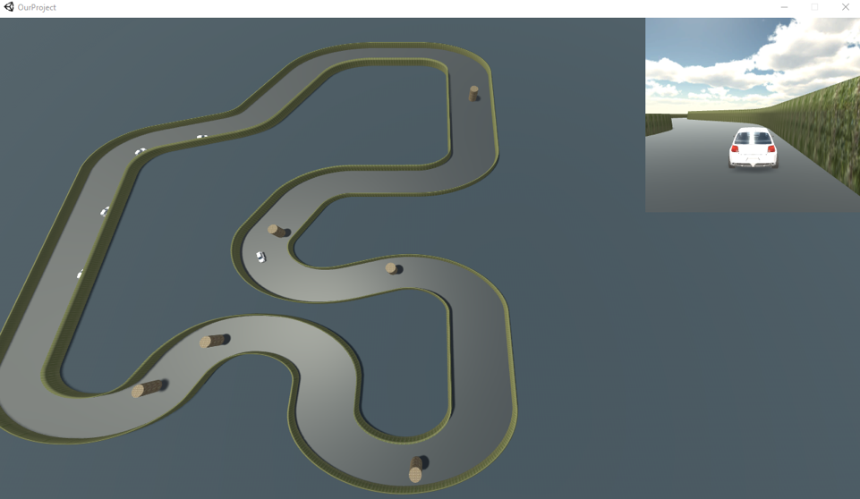
Our Project
Main goal – creating environment for training and testing multi agents reinforcement learning algorithms.
Sub goals:
User friendly
Realistic
Scalable
modular
Performance base line

Slide 12
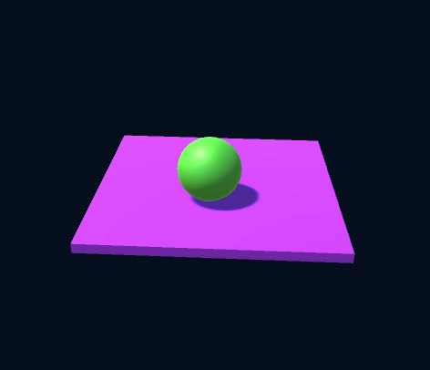
Working Process
Unity and Python development
Algorithm implementation
Tuning and getting base line results
Python
Unity build
DDPG
Python wrapper
Test/train
Agent
Wrapper
ML-agent
Brain object
MDDPG
ml-agent toolkit
MADDPG
Unity Graphic engine
Game Logic
(observations and rewards)
Notes:
- הפלאפונים סובבים אותנו. לכל אחד יש ולמה לא לנצל את זה לטובת איסוף מידע?
Personal cellphones have become an integral part of our lives
Many Applications, such as “waze”, are using that to create a large and effective database
Our concept is based on this principle while using many inner sensors onboard our cellphones, at any given time (such as temperature, gyro, magnetic field etc.)
the goal is to make an interactive map which shows processed sensors information acquired from cellphones that use the application

Slide 13
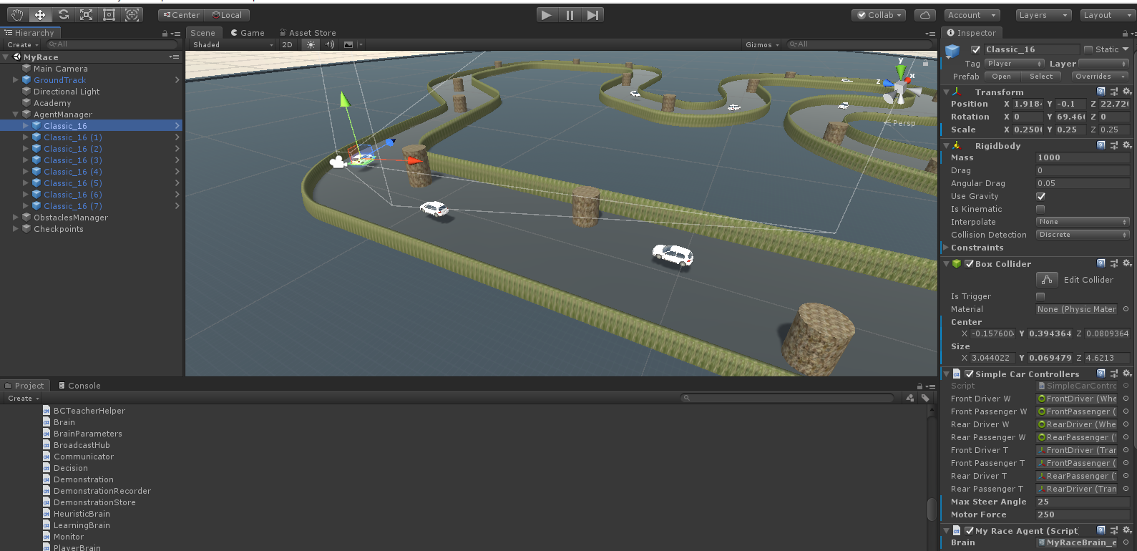
Unity
Notes:
- הפלאפונים סובבים אותנו. לכל אחד יש ולמה לא לנצל את זה לטובת איסוף מידע?
Personal cellphones have become an integral part of our lives
Many Applications, such as “waze”, are using that to create a large and effective database
Our concept is based on this principle while using many inner sensors onboard our cellphones, at any given time (such as temperature, gyro, magnetic field etc.)
the goal is to make an interactive map which shows processed sensors information acquired from cellphones that use the application

Slide 14
Unity
ml-agent Base Classes
Brain
Race Game Logic
Academy
Base Class, environment info
Agent
Base Class.
Send observations,
rewards and actions
Collision Signal,
and raw observations
Unity Physics
Convert Inputs to Unity Physics (wheel colliders)
Checkpoint Trigger
Notes:
- הפלאפונים סובבים אותנו. לכל אחד יש ולמה לא לנצל את זה לטובת איסוף מידע?
Personal cellphones have become an integral part of our lives
Many Applications, such as “waze”, are using that to create a large and effective database
Our concept is based on this principle while using many inner sensors onboard our cellphones, at any given time (such as temperature, gyro, magnetic field etc.)
the goal is to make an interactive map which shows processed sensors information acquired from cellphones that use the application

Slide 15
Unity
Obstacles
Race Game Logic
Initialize, Random Obstacles
Race Academy
Initialize Agents
Race Agents Manager
Initialization. Environment Info
Race Agent
Calculate Reward
Reward System
Collision Signal,
and raw observations
Send car input
Unity Physics
Car Controller
Convert Inputs to Unity Physics (wheel colliders)
Checkpoint Trigger
Checkpoint Trigger + Checkpoint Locations
Checkpoint
Checkpoint Trigger
Checkpoints Manager
Notes:
- הפלאפונים סובבים אותנו. לכל אחד יש ולמה לא לנצל את זה לטובת איסוף מידע?
Personal cellphones have become an integral part of our lives
Many Applications, such as “waze”, are using that to create a large and effective database
Our concept is based on this principle while using many inner sensors onboard our cellphones, at any given time (such as temperature, gyro, magnetic field etc.)
the goal is to make an interactive map which shows processed sensors information acquired from cellphones that use the application

Slide 16
Unity
ml-agent Base Classes
Obstacles
Race Game Logic
Brain
Initialize, Random Obstacles
Academy
Base Class, environment info
Race Academy
Initialize Agents
Race Agents Manager
Initialization. Environment Info
Agent
Base Class.
Send observations,
rewards and actions
Race Agent
Calculate Reward
Reward System
Collision Signal,
and raw observations
Send car input
Unity Physics
Car Controller
Convert Inputs to Unity Physics (wheel colliders)
Checkpoint Trigger
Checkpoint Trigger + Checkpoint Locations
Checkpoint
Checkpoint Trigger
Checkpoints Manager
Notes:
- הפלאפונים סובבים אותנו. לכל אחד יש ולמה לא לנצל את זה לטובת איסוף מידע?
Personal cellphones have become an integral part of our lives
Many Applications, such as “waze”, are using that to create a large and effective database
Our concept is based on this principle while using many inner sensors onboard our cellphones, at any given time (such as temperature, gyro, magnetic field etc.)
the goal is to make an interactive map which shows processed sensors information acquired from cellphones that use the application

Slide 17
Python
Main – User command line Interface.
Test, Train – train and test sessions that communicate with Unity
Agents – Learning algorithms implementation
DDPG - Deep Deterministic Policy Gradient
MDDPG - Multi-DDPG
MADDPG - Multi-Agent-DDPG
Notes:
- הפלאפונים סובבים אותנו. לכל אחד יש ולמה לא לנצל את זה לטובת איסוף מידע?
Personal cellphones have become an integral part of our lives
Many Applications, such as “waze”, are using that to create a large and effective database
Our concept is based on this principle while using many inner sensors onboard our cellphones, at any given time (such as temperature, gyro, magnetic field etc.)
the goal is to make an interactive map which shows processed sensors information acquired from cellphones that use the application

Slide 18
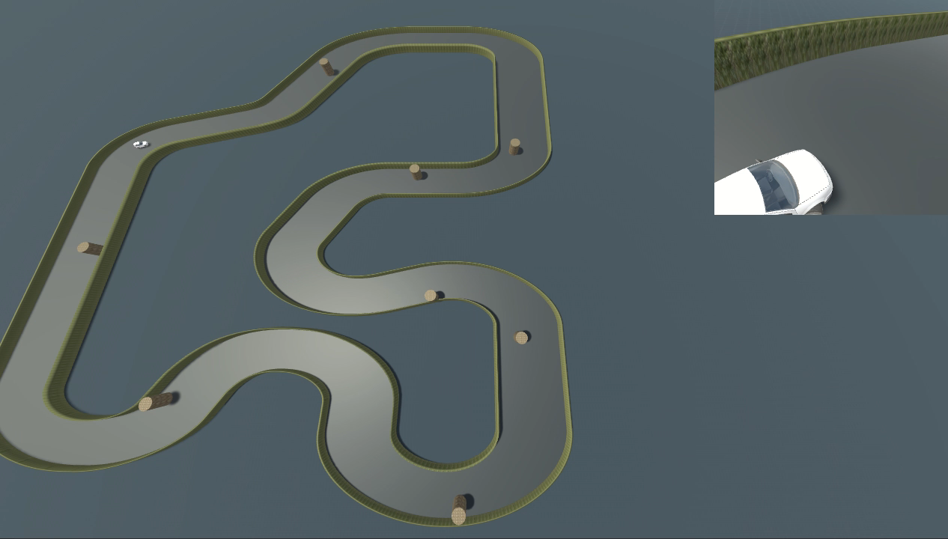
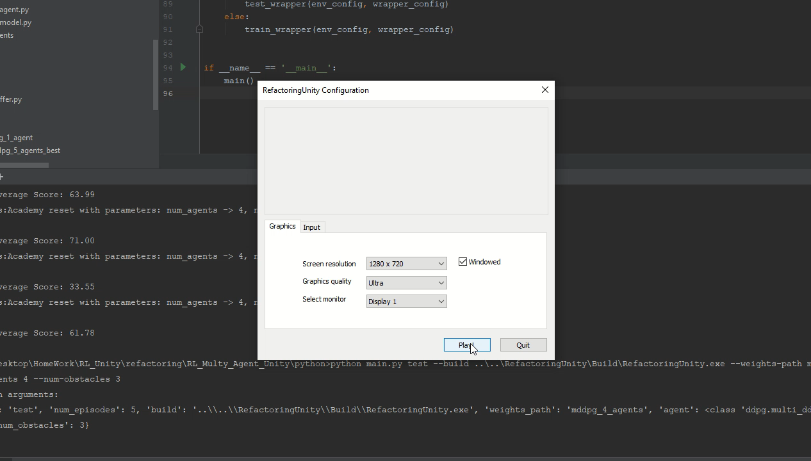
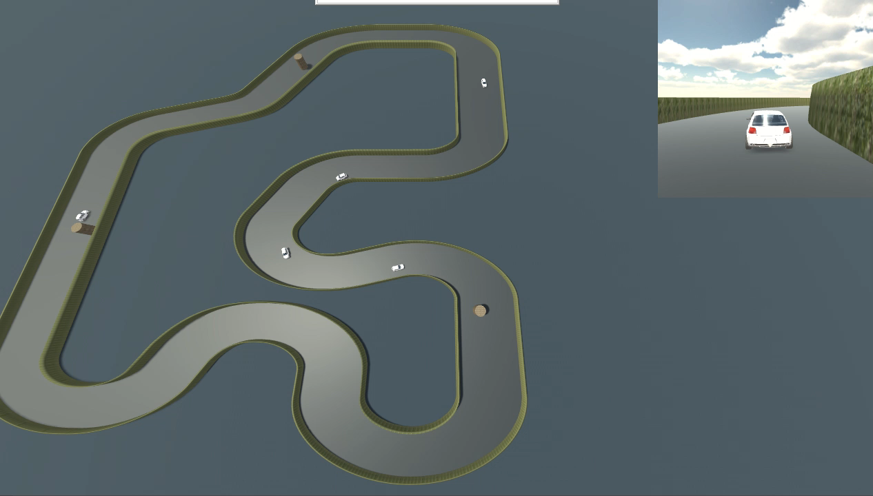
Results

Slide 19
Results Performance Base line

Slide 20
Results Performance Base line

Slide 21
Results Performance Base line

Slide 22
Conclusions
Contribution
Open source environment for other researchers to use.
Pre-training extension that could be research more.
Meeting our goals
User friendly
Realistic
Scalable
modular
Performance base line
Personal contribution:
Learning about machine learning and reinforcement learning.
Learning how to work with Unity environment.
Learning how to work with PyTorch library.
GitHub page
https://github.com/ShaharGottlieb/RL_Multy_Agent_Unity.git

Slide 23


